Slide 1
Design:Foundation

Slide 2

Table of content
At the end of this course, the participants should be able to:
Demonstrate design for a simple module
using basic design concepts like Modularity, Abstraction, Information Hiding
Refine the design using factoring
Demonstrate understanding of
Finite State Machines (FSM)
Layered design with Client-Server model

Slide 3
Foundation
Design
In this session, each one of you needs to create a design document!
Exercise
mixed with
Knowledge

Slide 4
DeSIGN
First, a discussion
What is design?
Why is it important to have one?
How do we make one?
Notes:
10 minutes:
Discuss the definition of design
Wikipedia says “Software design is the process by which an agent creates a specification of a software artifact, intended to accomplish goals, using a set of primitive components and subject to constraints”.
It is the blueprint of how a software needs to be implemented.
Encourage the participants to discuss what happens if we don’t have a design phase and get into coding straight away.
For small activities like Coding a search algorithm, it may be easy to code directly, but if you want to implement a larger system, while making sure that all its requirements are satisfied (and that others are ok with your approach), it makes more sense to make a design document first.
Design helps organize your thought process before coding.

Slide 5
Klocwork
Let us try and make one!

Slide 6
Klocwork
Design for a Protocol decoder
Main tasks
Register with network module
Pick Protocol messages from an IPC. Each message has a unique ID #.
Decode and store in C structures
Write back result to the Network Manager in a message with two parts-
First part : Shows ID # and result as OK or Not Ok based on whether the syntax of input was correct or not
Second part: If OK also send C Struct binary
Menu Interface
Protocol Decoder
Start/Stop
Protocol message
Message status, C struct as payload
Network Manager
Notes:
Discussion: 10 minutes
The participants need to develop the protocol decoder

Slide 7
Klocwork
Steps in module design
Identify the main tasks
Design the interface APIs
Work out the sequence diagrams
Data modeling
Which are the important data
Which structures shall be used
Control/Behavior modeling
Which events shall trigger a reaction – Event List
FSM
Functional decomposition
Break into smaller functions - apply factoring
Pseudocode

Slide 8
Klocwork
Identifying the main tasks
Exercise
What are the different sub-modules you can identify?
What is their sequence?
Is there any underlying pattern?
Step back – look at the big picture
Refine the task list
Do you have the complete list?
Do they have the right description?

Slide 9

Klocwork
Identifying the main tasks - example
What would be the sub-modules of a CLI module?
User Commands
Command output
CLI Module
Validated Commands
Command output
Core Application

Slide 10
Klocwork
Identifying the main tasks - example
User Commands
Command output
CLI Module
Parser
Application Interface
Validated Commands
Command output

Slide 11
Klocwork
How do we know that we have identified all the main functionalities?

Slide 12

Klocwork
Time to tell you about “Abstraction”
It helps move forward in working towards a solution by
Some level of generalization
Ignoring (for now) lower level details
Abstraction in Software Development
Requirements Definition - Define “What” system will do before “How”
Architectural Design – Define system overall structure before module details
Detailed Design - Design module before coding

Slide 13

Klocwork
Design Examples
Lets discuss 3 examples:
Designing a car from scratch!
The error handler function
The London Metro!

Slide 14
Klocwork
Abstraction – use in High level design
1st approach
Discuss internals – fuel transmission, engine size, gearbox
Will never complete the design
Cant guarantee that all areas covered
10000 feet view
What are the absolute basic functionalities
To be able to move from A to B
To carry people
Now break these two functionalities
Abstraction makes sure you don’t miss out on the big picture

Slide 15
Klocwork
Abstraction – Use in low level design
What is the problem with this pseudocode
Function validateInput (UCHAR choice, UINT16 empVal)
UNT16 num=0
Fetch default value from globalDefault(). Store in num.
Compare num with empVal
If num is greater than empVal
printf(“Value of empVal too high”)
Return PRJ_FAILURE;
Call processVal with choice and empVal
Return repsonse to calling function
Notes:
To work out the problem in low level pseudocode, answer these two questions
What are the assumptions being made.
Here printf is assuming that there is a console. What is there isnt one?
Once you isolate an assumption, ask what is the actual intent?
Actual intent is to share error with the user
So a better abstract equivalent of printf is shareError()

Slide 16
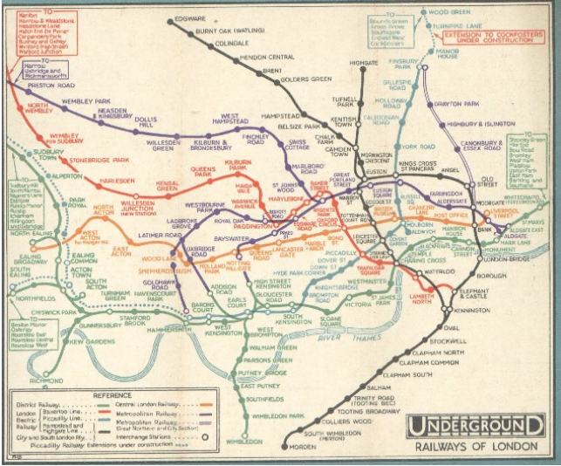
Klocwork
Abstraction –in Usability Design
London metro map – 1928
How to go from Quesns Park to the Oval?

Slide 17
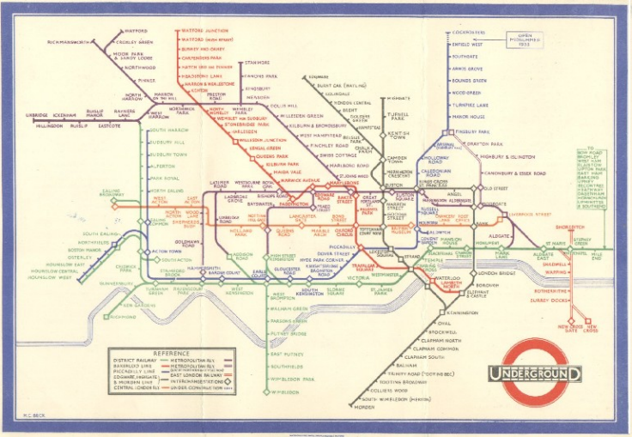
Klocwork
Abstraction –in Usability Design
Harry Beck modified the map in 1933
We still use this template!!!

Slide 18
Klocwork
Relook at the main tasks
User Commands
Command output
UI handler
CLI Module
Parser
App Interface
Validated Commands
Command output

Slide 19
Klocwork
Identifying the main tasks…
Exercise
Now that you know abstraction
can you rework on the tasks in your case study?

Slide 20
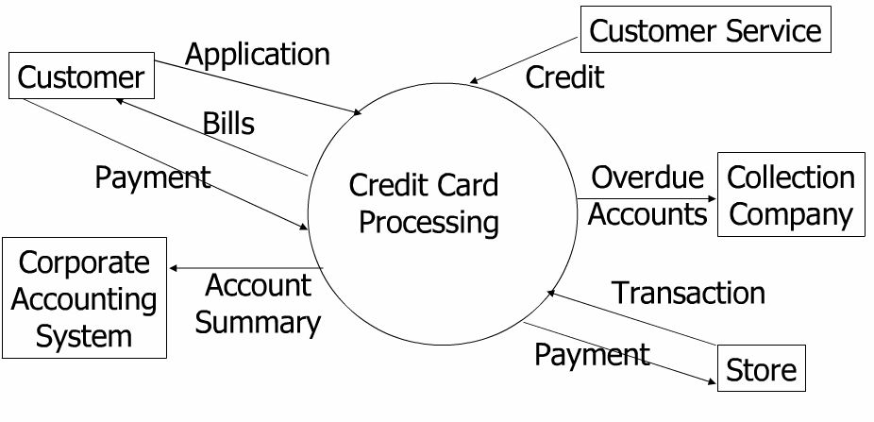
Klocwork
Interface APIs
How will this module talk to the outside world
Make a Context diagram to help identify the interface APIs?
What makes a good Interface API?

Slide 21
Klocwork
Interfaces
Interface: Functional
Decode_cmd()
Response :A Cmd Id upon success, else an error code
Menu/
Command response
User Commands
Interface: shell based
User types in command at prompt
>>
User
command
UI handler
Parser
Cmd id/Syntax error
Cmd id, Response
Cmd id, Internal command
Interface: Functional
App_cmd_response()
Response text is passed to the UI handle
Interface: Functional
App_process_cmd()
Response: success/failure
App Interface
IPC interface towards Core application

Slide 22
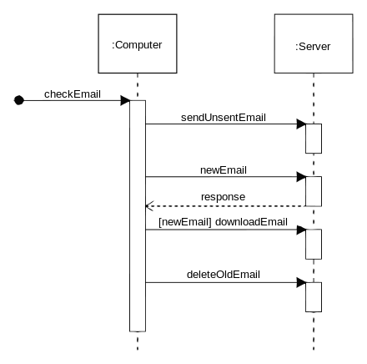
Klocwork
Sequence diagrams
Why are sequence diagrams important?
What are the various scenario possible?
What about error scenario?
Sample: An email message sequence

Slide 23
Klocwork
Sample sequence diagram
User
CLI interface
Parser
App interface
Cmd Prompt
Valid Cmd
Decode_cmd()
App_process_cmd()
App_Cmd Response
Cmd Response
Cmd Prompt

Slide 24
Klocwork
Sample sequence diagram - 2
User
CLI interface
Parser
App interface
Cmd Prompt
Invalid Cmd
Decode_cmd()
Error Response
Error Response
Cmd Prompt

Slide 25
Klocwork
Sample sequence diagram - 3
User
CLI interface
Parser
App interface
Cmd Prompt
Valid Cmd
Decode_cmd()
App_process_cmd()
timeout
App_Cmd Response(error)
Error Response
Cmd Prompt
App_Cmd Response
<discarded>

Slide 26
Klocwork
Interfaces and Sequence Diagrams
Exercise
Identify the interfaces in your modules

Slide 27

Klocwork
Data Modeling
Exercise
Exercise
Work out the important data common across the tasks
Which structures can we use to model them?
What are the typical issues around structure design?

Slide 28
Klocwork
Sample structures - CLI
Data common across the CLI interface example
Commands
Error codes
Valid response

Slide 29
Klocwork
Command structures
Typedef enum {
GET,
SET,
LOGIN,
LOGOUT,
LOGS,
}prj_cmdname_et;
typedef struct cmd_struct {
prj_cmdname_et cmd_name;
uchar cmd_option;
uint cmd_param1;
uint cmd_param2
}prj_cmd_st;

Slide 30
Klocwork
Command structures
Look at this command..
>get_list 1*(filename search-string)
How would the command structure be modified to accommodate this?

Slide 31
Klocwork
Command structures
typedef struct cmd_struct {
prj_cmdname_et cmd_name;
union {
struct cmd_small {
uchar cmd_option;
uint cmd_param1;
uint cmd_param2},
struct file_list {
char *file_name;
char * search_string[MAX_LEN];
struct file_list *next;}
}prj_file_list_st;
Typedef enum {
GET,
SET,
LOGIN,
LOGOUT,
LOGS,
GET_LIST
}prj_cmdname_et;
Notes:
Similarly you can work out structures for passing error information

Slide 32

Klocwork
Klocwork Error :Buffer Overflow/Array bound Violations
Identify the Common structures across your modules

Slide 33
Klocwork
Behavior Modeling
Exercise
Events trigger a reaction from the system
They also help decide the behavior across time
Identify all possible events which can hit the decoder module
Temporal events
Flow oriented
Control events
Module
Timeout
Data Packet
Hardware interrupt
Notes:
FSM = 30 minutes
Event List
The event list is a narrative list of the "stimuli" that occur in the outside world and to which our system must respond. There are essentially three different types of events: flow-oriented events (labeled as F), temporal events (T), and control events (C).
A flow-oriented event is one associated with a data flow; that is, the system becomes aware that the event has occurred when a piece of data (or possibly several pieces of data) has arrived.
Temporal events are triggered by the arrival of a point in time, not by incoming data flows; one might imagine that the system has an internal clock with which it can determine the passage of time. However, keep in mind also that a temporal event may require the system to ask for inputs from one or more terminators. Thus, one or more data flows may be associated with a temporal event.
Control events could be considered as a special case of temporal event: an external stimulus that occurs at some unpredictable point in time. Unlike the temporal events, the control event is not associated with the regular passage of time, so the system cannot anticipate it by using an internal clock. And unlike the normal flow-oriented event, the control event does not make its presence known by the arrival of data.

Slide 34

Klocwork
Finite State Machine
The FSM a model of behavior
Its sole purpose is to function as a controller between states and execute the necessary actions based on the events passed to it.
Suppose a ball comes bouncing towards a person
What does that person do ?
Depends on who the person is!!!
A baby, a child, an young man or an old man!
The event is the same (ball bouncing), but the behaviour depends on the state of the person

Slide 35
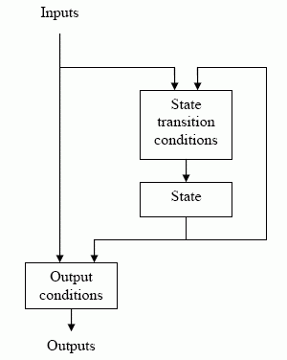
Klocwork
Characteristics
1) A collection of states and transitions that outline a path of actions that may occur.
2) State :A state is a position in time. For example, when you are at the bus stop, you are currently in a waiting state.
3) Event : An event is something that happens in time. For example, the bus has arrived.
4) Action :A task performed given a certain event that occurred. For example, you enter the bus.
5) Transition :A link between 2 states. May be unidirectional or bidirectional.

Slide 36
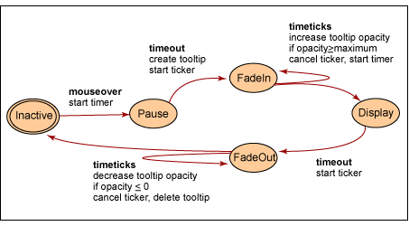
Klocwork
FSM example : State graph for Fading-Tooltip widget

Slide 37
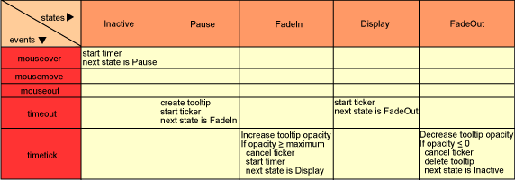
Klocwork
FSM example : State table for Fading-Tooltip widget

Slide 38
Klocwork
Sample FSM – CLI interface
Error Msg printed
IDLE
Input Cmd
WAIT
Invalid Cmd
Error_cmd
Cmd Reponse
Response printed
Print
response

Slide 39
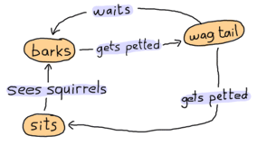
Klocwork
FSM
Exercise
Work out the FSMs in your design
Module level
Parser level
Any other?
Notes:
Ask participants to make FSM of IPv4 address
20 minutes

Slide 40
Klocwork
Functional decomposition
Exercise
Need to break down the tasks into smaller tasks
Keep repeating this
For how long?
How do we know when to stop
Notes:
Breaking a task – 30 minutes
We stop when we can define the given task is one line. E.g. This task is for sorting the list.

Slide 41
Klocwork
Time to learn about “Modularity”
Divide and conquer!
Separately named and addressable components
Advantage
Software development can be better planned
Changes can be more easily accommodated
Testing and debugging can be more focused
Functional independence is a is a direct outgrowth of modularity
Cohesion
Coupling

Slide 42

Klocwork
Cohesiveness
Module cohesion
Measure of internal strength of module
Degree to which a Module performs .... one and only one defined task
Goal is to be highly cohesive

Slide 43
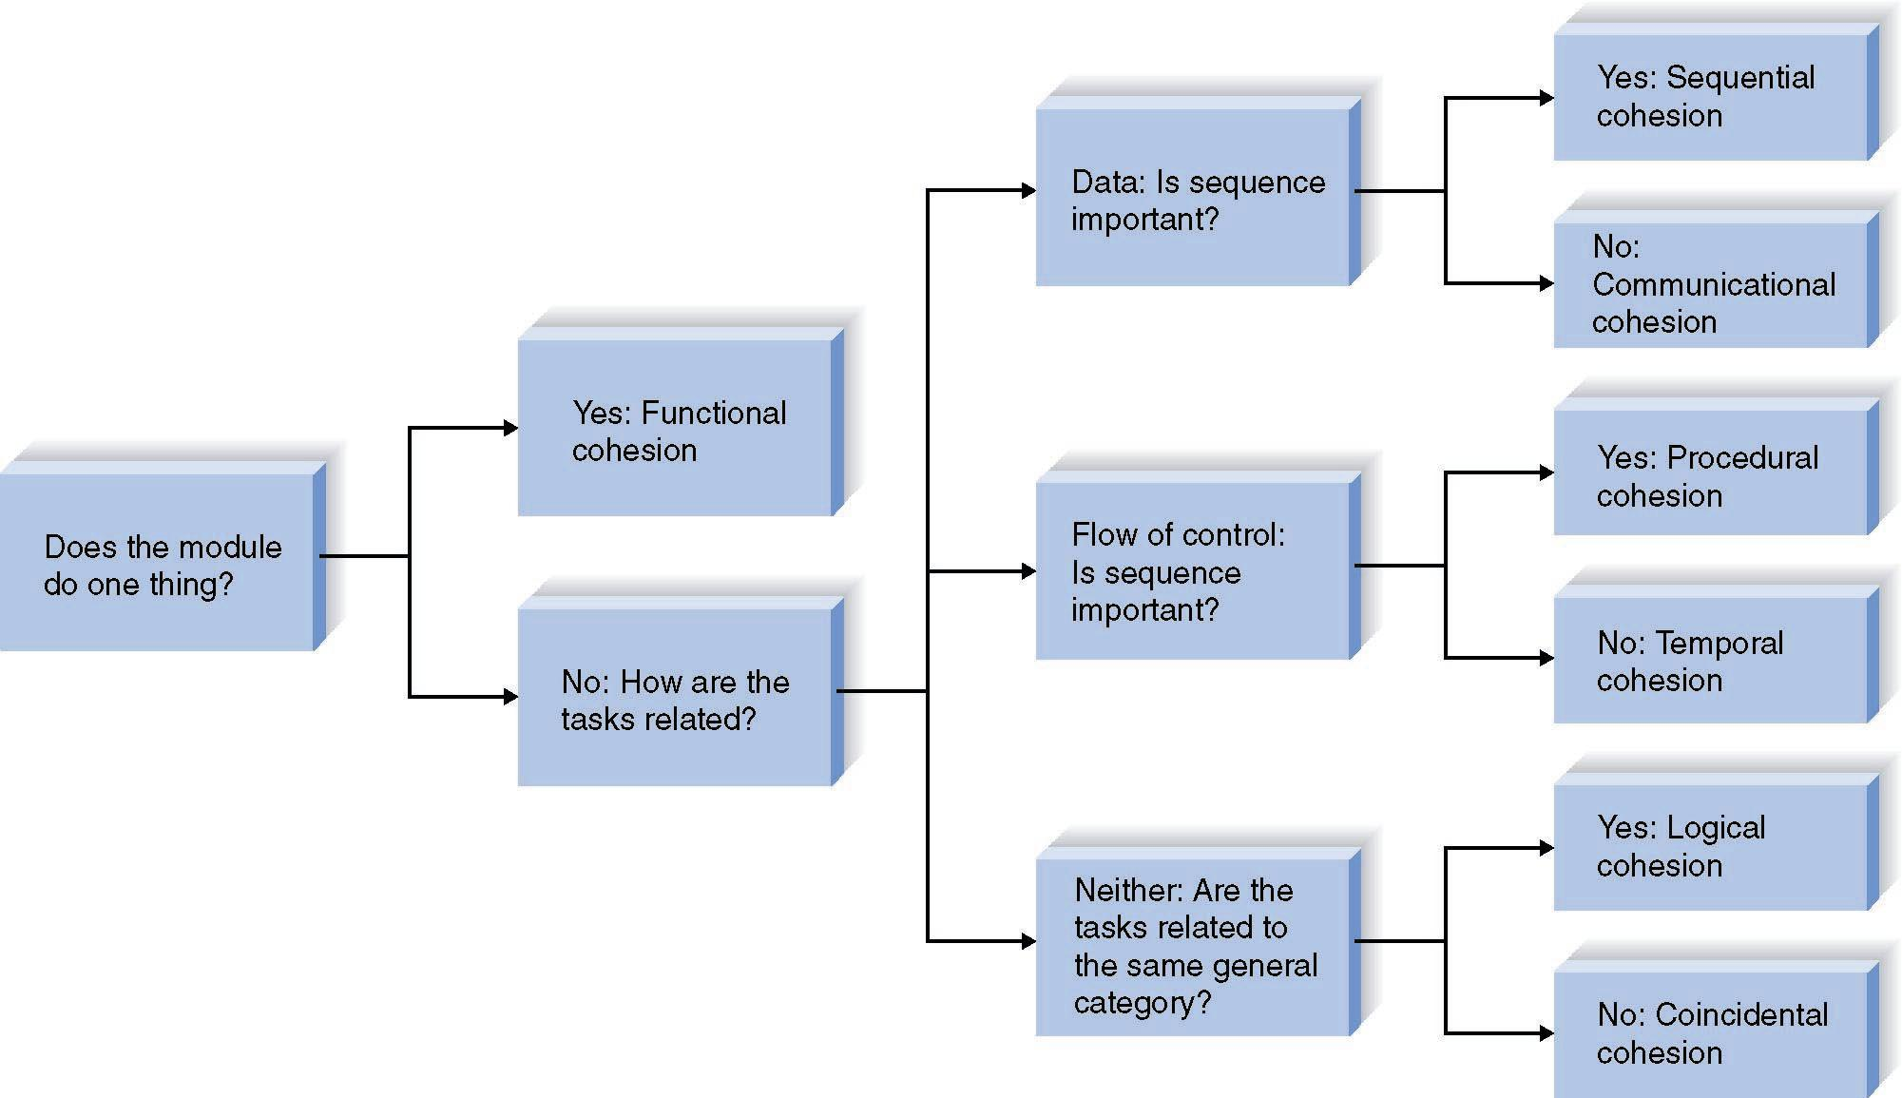
Klocwork
Cohesiveness
Its not practical to have function with just one task
- So what are the alternatives?

Slide 44
Klocwork
Breaking down the Parser module
Extract cmd
Cmd parsing
Validate cmd
Find parameter info
Parser
Validate parameters
Parameter parsing
Move to C struct
Pass C struct to App Interf

Slide 45
Klocwork
Coupling
Module coupling
Degree to which a module is connected to other modules in the system
Goal is to be loosely coupled
Ideally only parameter level sharing should happen across modules

Slide 46

Klocwork
What about “Information Hiding”
Users of a module should not know about how that module works
E.g., printf -> user need not know how it is actually implemented
Accessed by operations
Advantage
Modules are more self-contained
Results in more modifiable -> maintainable system
Is information hiding always good!
Lets discuss!
Notes:
Need to show that exchanging information about errors is vital

Slide 47
Klocwork
Information Hiding
A dashboard module of an HR system calls the training module to get training information. Which is the best option?
get_training_info(emp_id, &trg_data)
get_training_info(emp_struct, &trg_data) // emp_struct is entire employee data
gt_training_info(emp_summary_struct, &trg_data) // emp_summary_struct is a small struct which currently stores only employee data
Notes:
There is no correct answer – one needs to know all options and their pros and cons.

Slide 48
Klocwork
Attributes for good function prototype
Extensibility of the parameters
Consistent well defined interface/API format
Adding error handling
Adding details of initialization and termination
Testability of the module
Protocol_return_type_et Protocol_decode( [IN] Protocol_U16 mesg_type,
[IN] Protocol_char *curr_ptr, [IN] [OUT] Protocol_char *p_curr_state [OUT] Protocol_mesg_st *p_mesg
[OUT] Protocol_err_et error_type
)

Slide 49
Klocwork
Function details
How to describe what the function should do
flowcharts
pseudocode

Slide 50
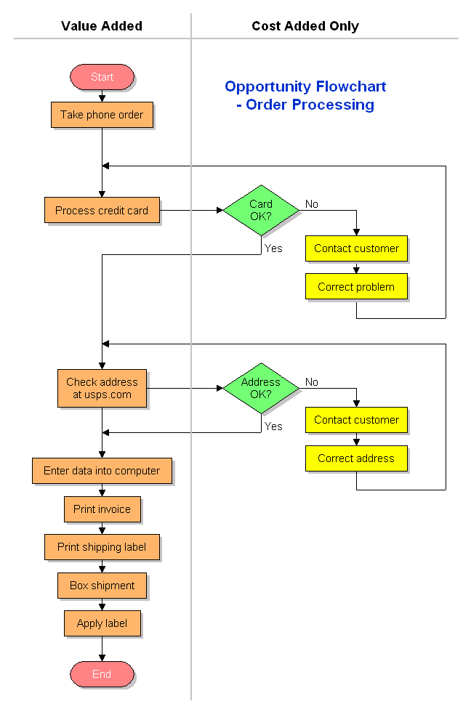
Klocwork
A quick look at Flowchart

Slide 51
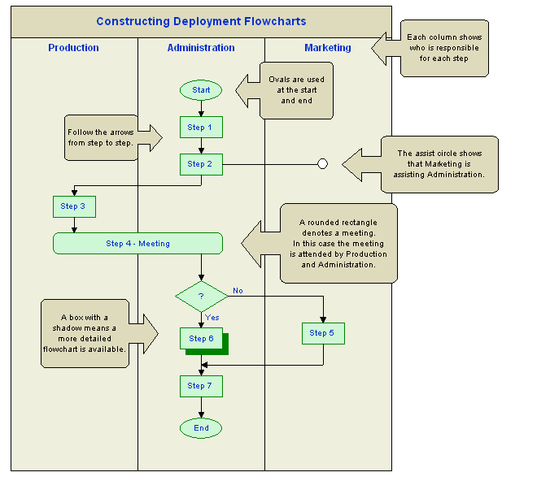
Klocwork
Storyline flow of flowcharts

Slide 52

Klocwork
Function level design flow
Open your code editor
Pen down the function design in comments format
Apply factoring to resize/break the function
Refine till function set is
Loosely coupled
Highly cohesive
(later you can write the code in between the comments)

Slide 53
Klocwork
Factoring to make function smaller
Separate regular tasks into different modules
read and write modules,
error-handling modules,
initialization and termination modules, etc.
Creating too many functions can be controlled by the use of inline functions.
Avoid using macros for small functions – difficult to debug

Slide 54
Klocwork
Factoring to make function smaller
Reduce/isolate use of control flags
A control flag is a variable which triggers an if and an else
u_char gender
gender=fetch_gender(empid)
if(MALE==gender)
{
//task1
}
else
{
//task2
}
//other tasks
Split the function if it has too many control flags.
Data flags should also be limited to 7 or less.

Slide 55
Klocwork
Factoring to make function smaller
High Fan-in and low fan-out preferred
Fan-in:
indicates how many modules directly invoke a given module.
High fan-in represents code reuse and is in general encouraged.
1.1
Calculate
Employee
Salary
1.2
Print
Employee
Roster
1.3
Calculate
Benefits
2.1.1
Read
Employee
Record
Fan-out:
a measure of the number of modules directly controlled by given module.
1.1
Calculate
Employee
Salary
1.2
Print
Employee
Roster
1.3
Calculate
Benefits
1.1.1
Read
Employee
Record
1.2.1
Read
Employee
Record
1.3.1
Read
Employee
Record

Slide 56
Klocwork
Factoring – Low Fan-out
main
A
main
A
X
B
B
Y
C
C
D
D
E
E
Can you improve the fan-out ratio?

Slide 57
Klocwork
Complete the design!
Exercise
List the functions, their prototypes
Define them
What did we learn?

Slide 58
Klocwork
References
Abstraction – the key to Computing? – Jeff Kramer
Pseudocode Programming Process
http://en.wikipedia.org/wiki/Sequence_diagram
http://www.uml-diagrams.org/sequence-diagrams.html
Definitions of Software Architecture - http://www.bredemeyer.com/definiti.htm

Slide 59
Klocwork
Disclaimer
Aricent Group makes no representations or warranties with respect to contents of these slides and the same are being provided “as is”. The content/materials in the slides are of a general nature and are not intended to address the specific circumstances of any particular individual or entity. The material may provide links to internet sites (for the convenience of users) over which Aricent Group has no control and for which Aricent Group assumes no responsibility for the availability or content of these external sites. While the attempt has been to acknowledge sources of materials wherever traceable to an individual or an institution; any materials not specifically acknowledged is purely unintentional

Slide 60
Revision History
Revision History
Revision no. | Date | Description of change | Author | Reviewed and Approved By
0.1 | 29-oct-13 | Initial set | Shiv Kumar
0.2 | 6-Nov-13 | Post comments to reframe deck around classroom assignment | Shiv Kumar

